Slide 1


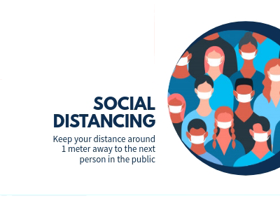

Covid – 19
Safety and awareness

